Slide 1


Real Estate Support Triage Agent

Slide 2
Problem Statement :
Build an AI-powered real estate support triage agent
Automate customer query handling
Perform structured property search
Integrate LLM for intelligent responses
Provide secure and scalable architecture

Slide 3
Low-Level Design Overview:
Modular backend architecture
Authentication Module
Chat & AI Processing Module
Tool Calling Mechanism
Database Interaction Layer
Error Handling & Security Layer

Slide 4
Authentication Module (LLD) :
User Signup with bcrypt password hashing
Login with hashed password verification
OTP-based password reset
SMTP email integration
MongoDB storage with secure schema

Slide 5
Chat Processing Flow (LLD) :
User message received via /chat endpoint
Message appended to conversation history
LLM analyzes intent & extracts parameters
If sufficient info → Tool call triggered
Response formatted and returned to frontend

Slide 6
Database Design :
Users Collection: Stores user credentials
Properties Collection: Buy/Rent listings
OTP Collection: Temporary password reset codes
TTL Index for OTP expiration (10 mins)
Async MongoDB driver (Motor) used

Slide 7
Architectural Decisions:
FastAPI for high performance & async support
MongoDB for flexible property schema
LangChain for tool calling orchestration
Gemini for reasoning & structured output
Modular separation for scalability

Slide 8
User Input
↓
Input Validator Module
↓
Preprocessing Module
↓
Intent Classification Module
↓
Urgency Detection Module
↓
Named Entity Recognition Module
↓
Context Builder
↓
Prompt Generator
↓
LLM API Call
↓
Response Formatter
↓
Final Draft Response
Component Level Architecture

Slide 9
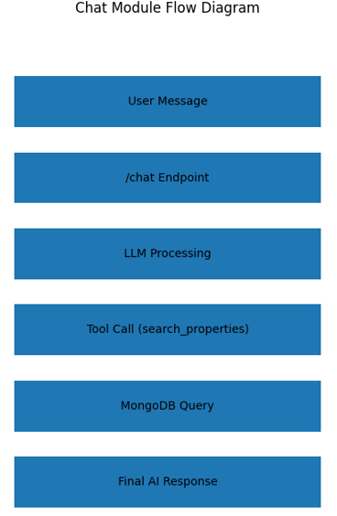

Slide 10
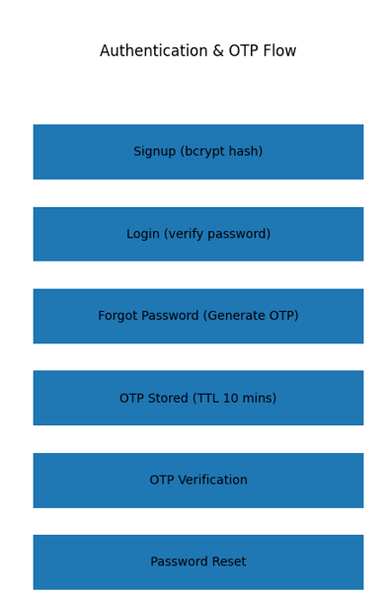

Slide 11
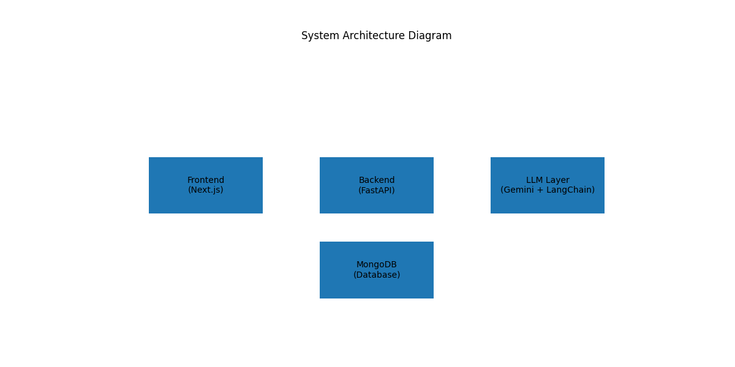

Slide 12
Thank You!

